Slide 1
Strategic Plan Review
June 1, 2017

Slide 2
Setting the stage
Strategic Planning Approach

Slide 3
Setting the stage
2015
ASIS retains Insigniam to lead new strategic planning process
Goal was to ultimately develop a plan for members/leaders by members/leaders
2016
Board and Strategic Planning Team (volunteers) worked with Insigniam through May/Jun; turned work over to Staff Team
Staff Team sought input from members, nonmembers, volunteers (anecdotal, social media, surveys, focus groups at Seminar)
Oct/Dec staff worked with The Wheelhouse Group to compile/condense/validate data and draft plan for Jan 2017 Board approval
2017
Board approved current Plan at January 2017 Leadership Meetings
All aspects of Plan tied to FY17 budget
Plan puts important stake in the ground BUT is a “living document”
Strategic Planning sessions run globally to create a full picture for ASIS
Global edits to core strategic plan by Board in Feb 2017
First Meeting of expanded Strategic Planning Committee in May 2017
1
2
3

Slide 4

Overview
The security profession makes the world a safer place and has a positive impact on the future of the organizations and stakeholders it serves.
We are the global leader in security professional development, education, and standards—transforming lives through the leadership we provide, the communities we create, and the products and services we deliver.

Slide 5
Promises
To our members, we promise:
best-in-class member services; opportunities to build relationships, exchange ideas, and share insights and best practices with peers around the globe; education and professional development opportunities that help you to be more effective in your job and that support you at every stage of your career; an opportunity to be involved in the direction and work of our Society; and to be a global advocate for and a positive impact on the profession.
To the employers of our members, we promise:
opportunities for your staff to access cutting edge knowledge, and to develop relationships with global and local industry experts that create value and reduce risk for your organization.
To our partners, exhibitors, and advertisers, we promise:
to be a good partner and to work together for the best possible outcome for our respective interests.

Slide 6
Promises
To our staff, we promise:
an empowering work environment and a culture of diversity, inclusion, and transparency; clear strategic intent to hold you accountable, and to reward you for fulfilling that intent; appropriate professional career development opportunities; and the opportunity to work on significant challenges that have global impact.
To governments, we promise:
to have open and transparent discussions with all interested governments about the importance
of standards, professional development, and the furtherance of public-private partnerships.

Slide 7
Our Strategic Bets for Future Success
ASIS International members' make-up, demands, and needs will continuously evolve. Therefore, our Society must be agile and have its hand on the pulse of members globally to know and to deliver what will make a difference for their careers and employers.
ASIS International must be the clearing house for the best security and risk management practices for all levels and specializations of our profession.
ASIS International must be the global face and voice of the security and risk management profession.
ASIS International is a leader in anticipating and dealing with emerging physical, cyber, and other threats from nations, organizations, non-nation-state actors, individuals, and new technologies.
Criminal and terroristic threats will become more cyber-related, physical and cybersecurity will converge, and the roles of the CSO and CISO will converge.

Slide 8



Three Key Tests
  Device Agnostic
  On-Demand
  Digital
  Geographically Relevant
  Market-driven
  IterativE Development
Mobile
Global
Agile

Slide 9
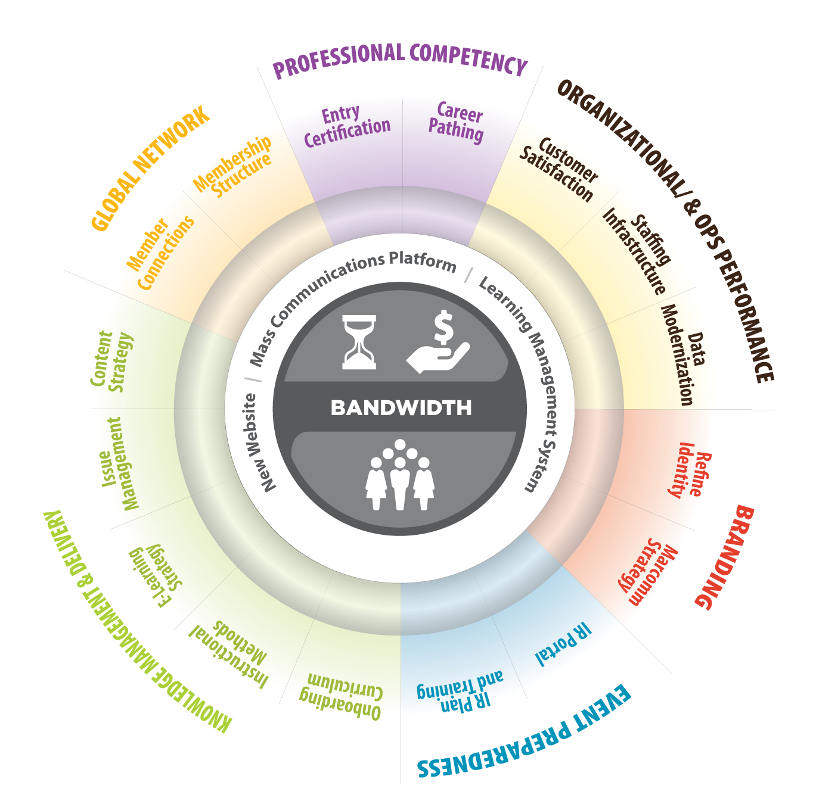
DependEncies
Transforming stakeholder Strategic Goals into actionable Initiatives
Break down each goal into targeted need
Identify what dependencies and operational prerequisites exist within ASIS today
Identify common key steps in each Goal and Initiative to efficiently meet strategic objectives
Prioritize key steps in each Initiative and map out next five years for ASIS
Notes:
How the Goals outlined by the board and the leadership have changed from broad and inspiring to tactical and actionable.
This graphic shows how larger goals cascade through the entire operation with the common restrictions of bandwidth, people, money and time.

Slide 10
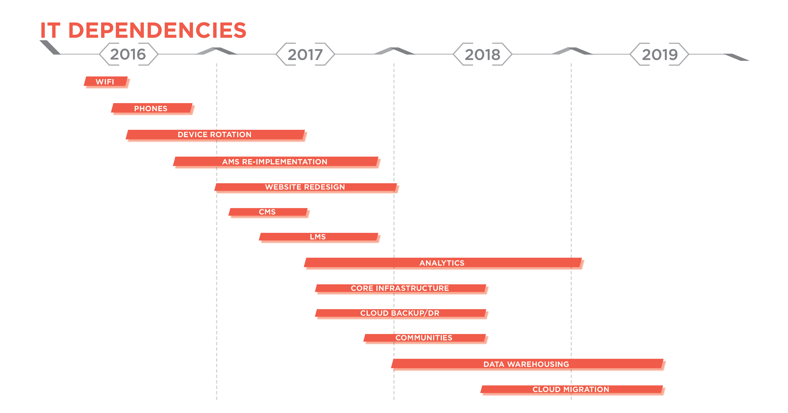
SETTING THE FOUNDATION
THROUGH DIGITAL TRANSFORMATION
Tasks that will be 90% complete by EOY17
Data cleanup
New Content Management System selected
Modern enterprise architecture
UX focus
New website AND online store
Association Management System launch
Fully integrated Learning Management System/Certification
Online community
Online S&G development tools
Notes:
To enable us to meet these strategic goals, ASIS is going through a digital transformation by updating our Association Management System, our website, our digital learning platforms and credentialing platforms. This also includes our day to day systems at HQ like laptops, Wi-Fi, and phones to enable our staff to be more responsive to member needs.

Slide 11

Success to date
2017 Progress Forecast

Slide 12


2017 Progress Forecast
Tasks that will be 90% complete by EOY17
Branding
Implementing strategic plan themes into current promotions
ESRM concepts weaved into 2017 event programming
Finalize branding strategy recommendations
Draft 3 of marketing communications plan
Advocate strategy plan developed
Global Network
Improved customer service response time
Volunteer leader newsletters and chapter conference call system ready to implement in Q2
Member Model Work Task Force
Career Mapping Task Force
Globalization and governance structure work initiation; Council Globalization pilot program

Slide 13


2017 Progress Forecast
Tasks that will be 90% complete by EOY17
Professional Competency
Reorganized department staff responsibilities to improve customer response time
Updated marketing and certificant communication materials
Complete entry-level certification market analysis and start job analysis
Streamlined application processing
Convert to new application module
Updated notification/communication policies
Redesigned certificates
Organization & Operations Performance
Enhanced internal information sharing
Filled 15 key staff positions across the organization
Develop new enterprise architecture that supports member experience and organization decision making
Refine staffing support for volunteer engagement to better serve key volunteer constituencies
Develop plan for focal point performance review process.
IT initiatives that support access to services and data

Slide 14


2017 Progress Forecast
Tasks that will be 90% complete by EOY17
Knowledge & Learning
Content audit
Implement eLearning platform
Council content outreach
Public launch of 2018 Issue Management Framework
Digital framework for content consolidation
Educational market analysis
Knowledge & learning gap analysis
Event Preparedness
RFP issued for firm to create media engagement plan
Staff identifying and sharing SMEs
Quick response webinar platform identified
Start implementation of media engagement plan
Incident response plan: KPIs created, plan shared with CVPs

Slide 15

Related Global Strategic Plans
ASIS is working with our partners on regional strategic plans that are targeted at local initiatives
Next step is to combine this local feedback into our Global Strategic Plan
    Europe (in process)
    APAC (in process)
    Middle East (slated for later this year)
    Latin America (slated for later this year)
Notes:
ASIS APAC Meetings Future Model Outline(March 2017)
ASIS EAC 2016 Strategy Meeting Summary
ME and LA are not yet completed

